Slide 1
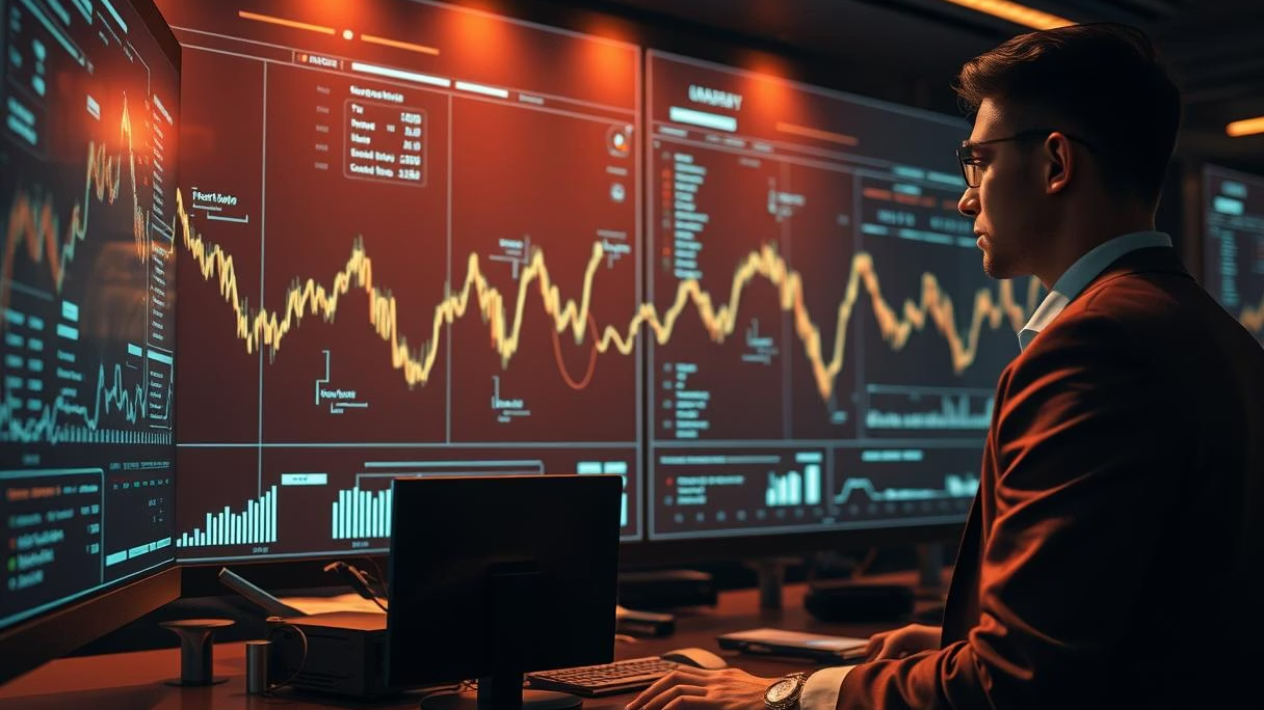

Slide 2



The Silent Enemy: Your Trading Mindset
Emotional Control
Ineffective Journaling
Repetitive Mistakes
90% of traders fail not from a bad strategy, but from emotional pitfalls like revenge trading, FOMO, or overtrading.
Traditional journaling is manual, inconsistent, and often ignored, failing to connect real-time emotion with performance.
Without insights into behavioral patterns, traders are trapped in cycles of error, hindering profitability and growth.
The real loss isn't just on the chart—it's deep within the psyche.

Slide 3
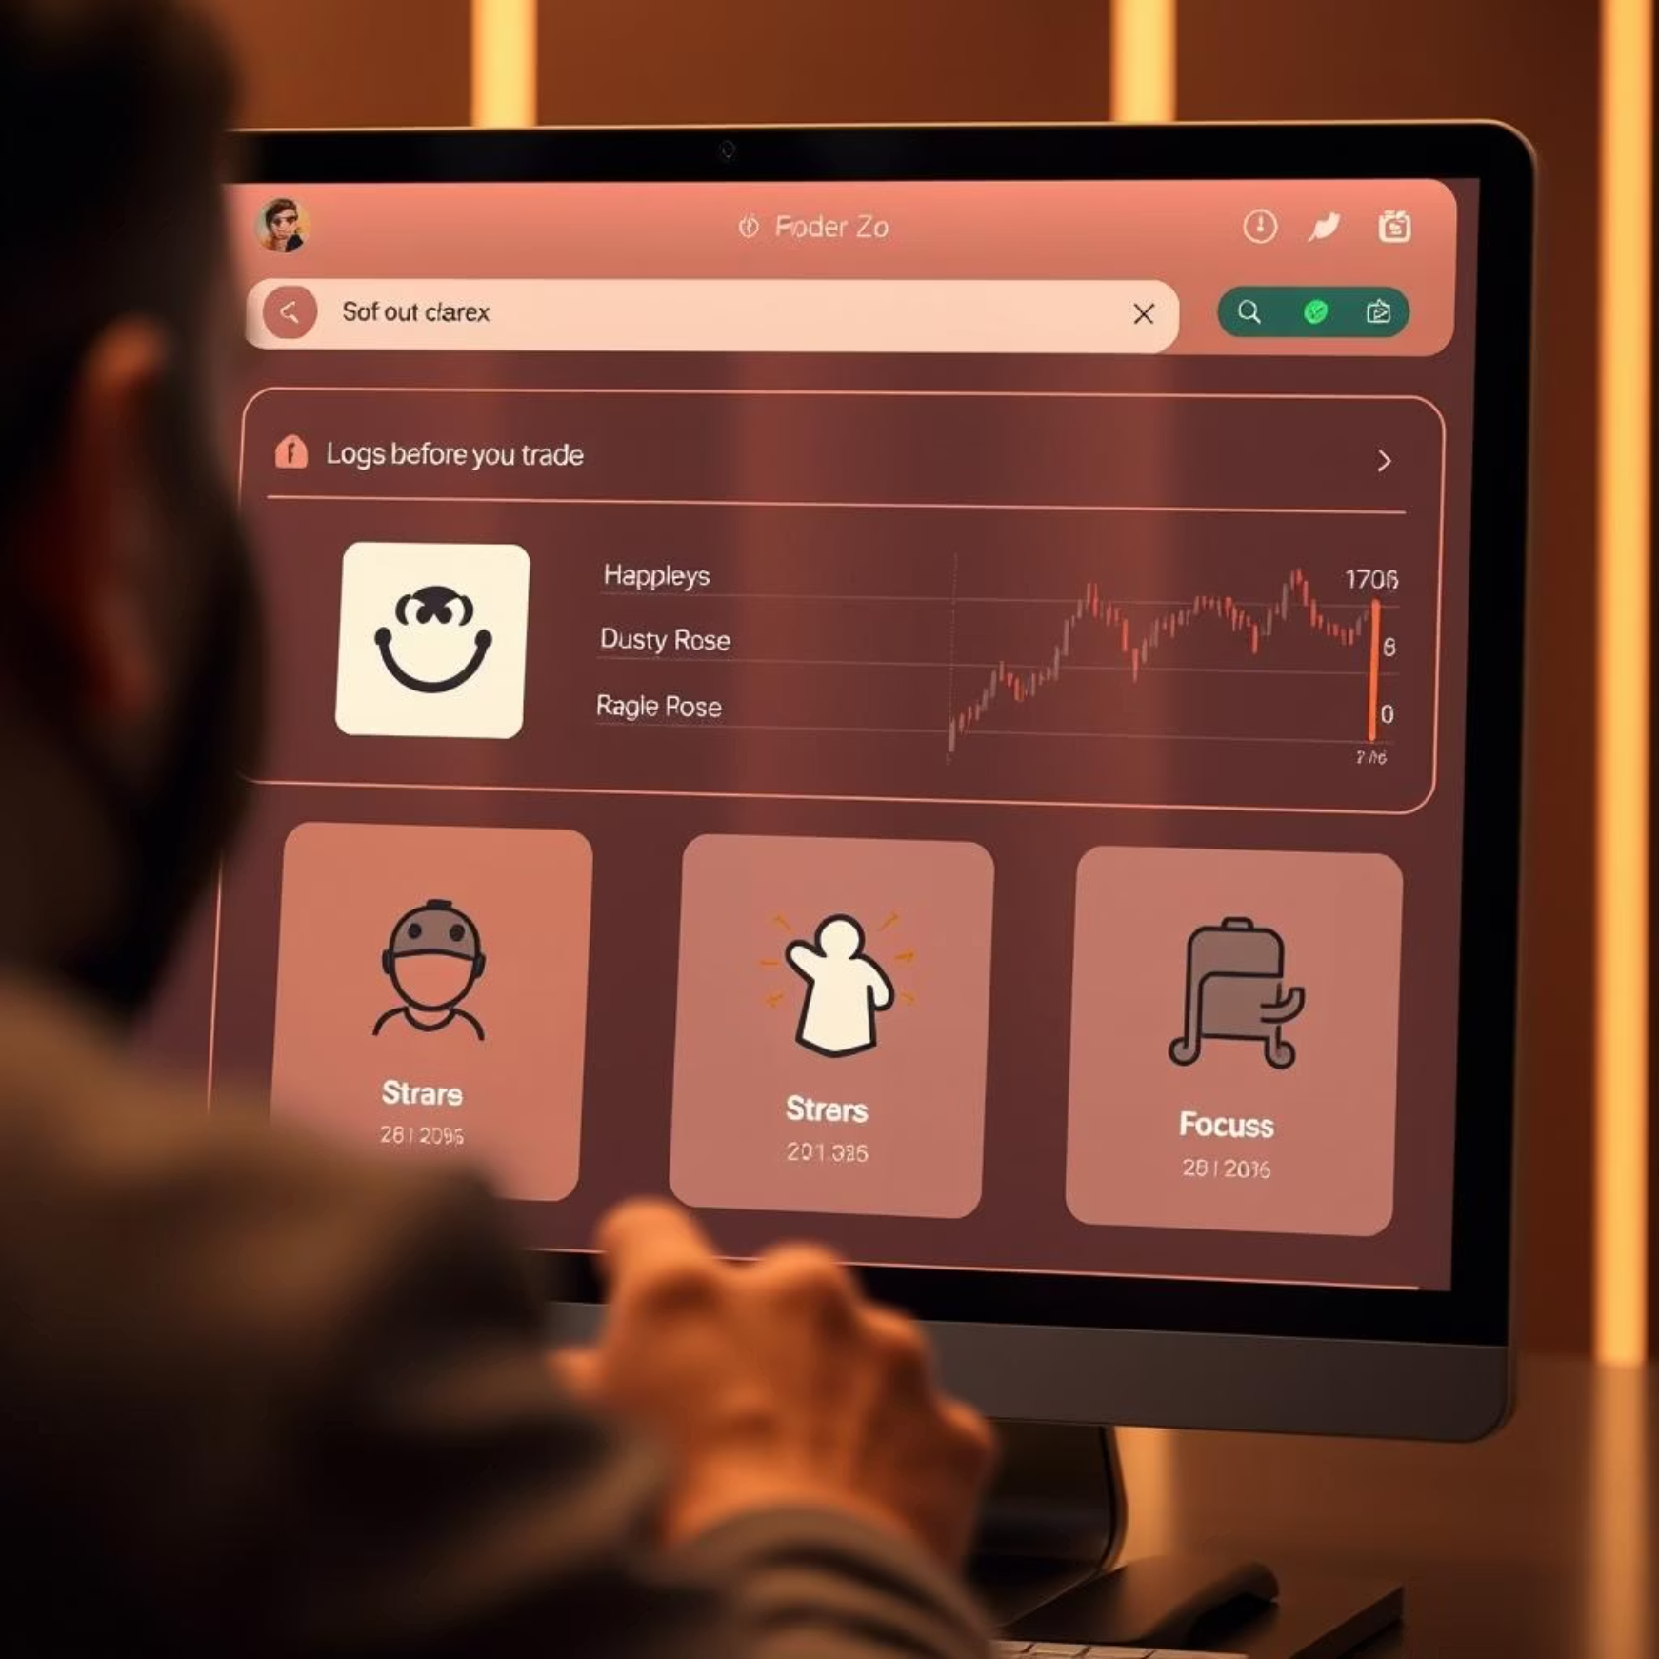
Introducing TradeMind: Your AI-Powered Behavioral Edge
TradeMind is the first AI-driven behavioral trading journal designed to transform how traders understand and master their emotions. We track your mind, not just your trades.
Emotion Logging
Capture pre and post-trade psychological states.
Discipline Checklists
Enforce rule-based trading with real-time feedback.
AI Coach (Deepseek + Hugging Face)
Personalized behavioral insights and actionable advice.
Premium Reporting
Monetized via IntaSend for in-depth analysis and growth to really get to the root of your losses.
You don't just log a trade—you analyze your psyche.

Slide 4
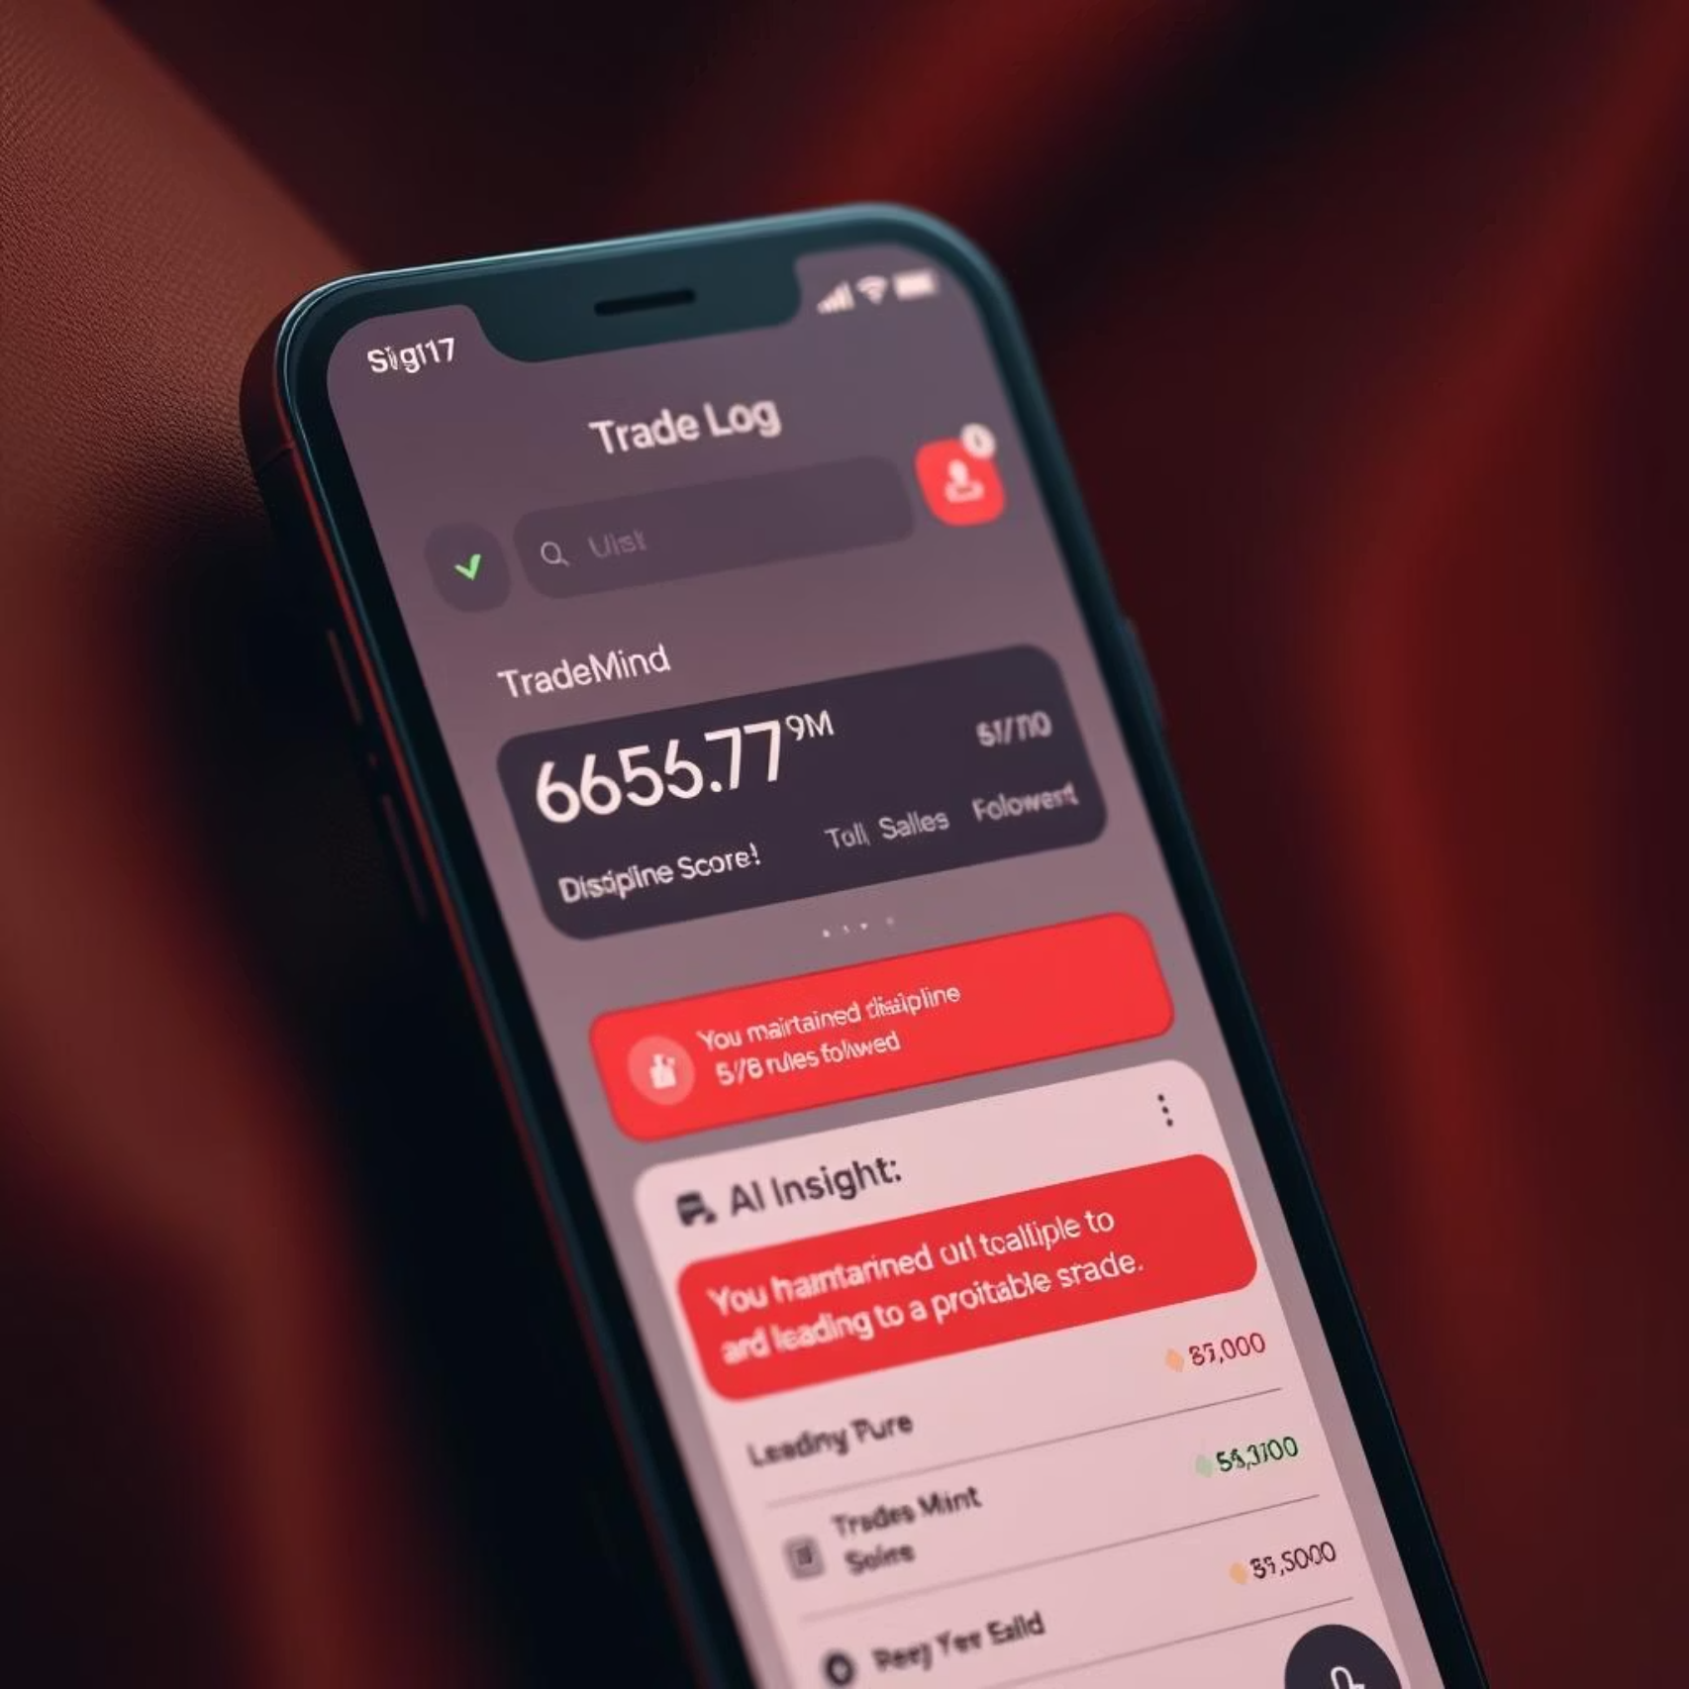
Core Features: Built for Traders, Backed by AI
Intuitive Design
"Your Edge Isn't Just Strategy — It's Your Psyche" landing page.
Customizable trader profiles (Day, Swing, Scalper).
Comprehensive trade log: Date, Pair, P/L, Emotions, Rules Followed.
Sleek dark mode for optimal night trading.
AI-Powered Insights
Real-time behavioral analysis.
Discipline scoring (e.g., 8/10).
Win rate tracking (e.g., 66.7%).
Actionable feedback: "You maintained discipline with 5/8 rules, leading to a profitable trade."
This isn't a mock—it's a live, working product, already delivering impact.

Slide 5


Who Needs TradeMind? Our Target Market
Active Retail Traders
Trading Coaches & Educators
Proprietary Trading Firms
Forex, Crypto, and Stocks—individuals seeking an edge beyond technical analysis.
Tools to empower their students with behavioral mastery.
Enhancing team discipline and performance metrics.
"I am not just trading the market—I'm trading my mind."

Slide 6
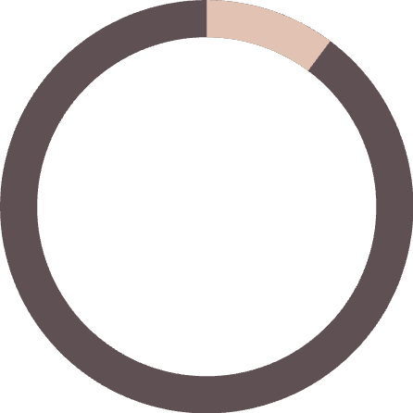
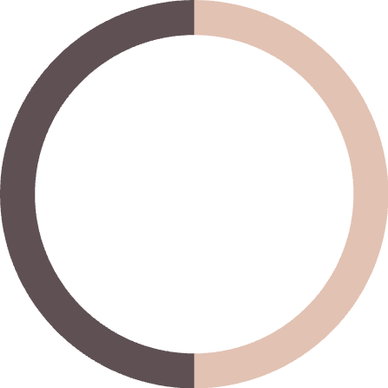


Market Opportunity: A $10B+ White Space
"TradeMind is poised to capture 1% of 1% of this market, equating to a $100M ARR opportunity."
10.2B
50M+
Global Retail Trading Market by 2027 (Statista)
Africa's Active Traders by 2030 (Fintech Boom)
<5%
Behavioral Finance Tool Adoption (Massive White Space)
50M Traders
Behavioral Gap
$10B Market
White Space

Slide 7
Competitors: They Look Back, We Lead Forward
TradingView
Charts & Ideas
No emotion tracking
Edgewonk
Trade Stats
No AI, just analytics
MyFxBook
Performance
No behavioral insights
Bear Bull Traders
Education
No journaling
They're rear-view mirrors; TradeMind is the GPS for your psyche.

Slide 8

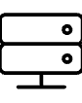

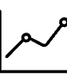
Our Unfair Advantage: AI + Emotion + Monetization
First AI Coach for Trader Psychology
Scalable & Secure Platform
A unique focus on mental well-being (SDG 3: Good Health).
Built on robust Django framework, ensuring reliability.
Seamless African Fintech Integration
Real-Time Discipline Scoring
Monetization via IntaSend, optimized for local payments.
Instant feedback to reinforce positive trading habits.
"We don't just show you what you traded—we show you why you lost."

Slide 9
Traction & Roadmap: Building the Trading OS
Current Traction:
Future Roadmap:
Live prototype with real AI insights.
01
IntaSend payment integration established.
Q3 2024
8+ rules and 5+ trades already logged.
Deployment on Render coming soon.
PDF export, Voice coaching feature.
02
Q4 2024
Mobile app launch (React Native).
03
2026
Prop firm partnerships.
04
2027
IPO or acquisition target.
We're not building a journal—we're building a trading operating system.

Slide 10
Our Ask: Fueling the Psyche Revolution
Investment Needed
In Return, You Get
$50,000
10% Equity
1 Full-Stack Developer (6 months)
First access to premium features
Render & AI API costs
Co-branded trading workshops
Mobile app development
A stake in the future of behavioral trading
Marketing & community growth
"This isn't just funding—it's fuel for the future of trading."

